Slide 1

Go Shopper
Better Prices, Better Shopping...
Team: Harsh Yadav (hy1217)
Datta Sainath D(dsd298)
Jayesh Patil (jpp421)
Shearyar Khan (ssk482)
Team No: C08
Professor: Fred Strauss
Subject: Software Engineering

Slide 2


CURRENT SCENARIO
Amazon & eBay: Platforms for buying/selling goods.
Still, we visit multiple ecommerce websites
Single and Most important Reason: Most Economical Product
But what do we buy more?
Weak Spot: “No online retail for Grocery stores”

Slide 3
MOTIVATION
No fixed prices in stores! Result: Most of the time, we end up spending more on same products.
IDEA: APPLICATION ECONOMICAL PRODUCT NEARBY STORES
What could be even better? Delivered at YOUR DOORSTEP
AIM: Let capitalism decide the prices of products. “Competition between local grocery store could lower the prices.”

Slide 4
WHO WILL BENEFIT FROM OUR APP
SAVE MONEY: Lower and Middle class households. Restaurants that have to deal with groceries daily.
SAVE TIME: No more waiting in queues. No more searching for products physically.
INCREASE BUSINESS: Grocery Stores
GET FRESH PRODUCTS without any hassle

Slide 5
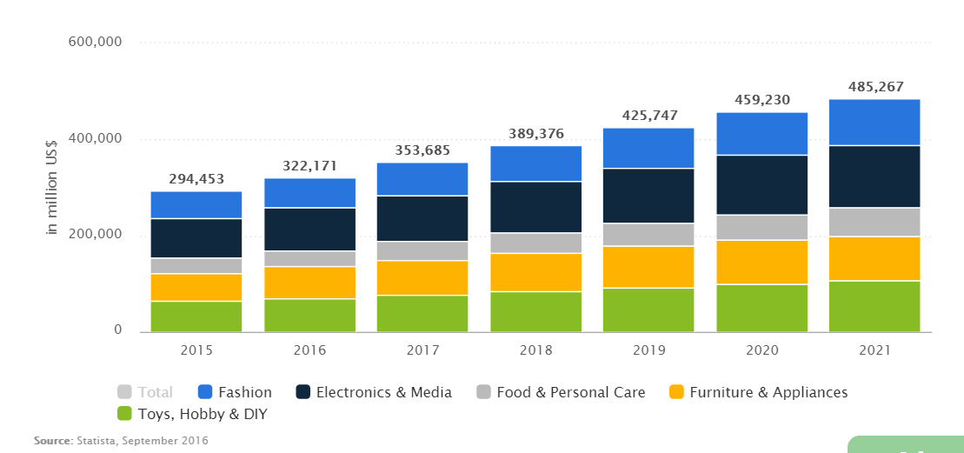
E-COMMERCE BUSINESS STATISTICS
Notes:
E-commerce business stats
Not much growth in food industry
People find cheap items in stores
Online grocery selling apps not yet available.

Slide 6



SIMILAR ALTERNATIVES IN MARKET
GASBUDDY: Low gas prices based on your location.
SHOPSAVVY: Similar products based on customer’s location with best prices offered at different places (Does not deal with groceries).
DECIDE: Tells correct time to buy an electronics product or he or she must wait until an offer is available on it. Only for electronics product.

Slide 7
REQUIREMENTS
Mobile System : Android, iOS.
Web Browser: Chrome, Mozilla Firefox, Safari
Handle Multiple Users.
Provide Secure Transactions.
Display Consistent and Updated Data.
Message passing between different entities should be secure and accurate.

Slide 8
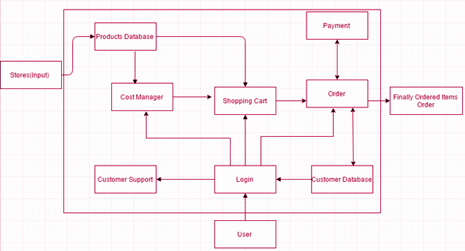
SYSTEM PERSPECTIVE

Slide 9
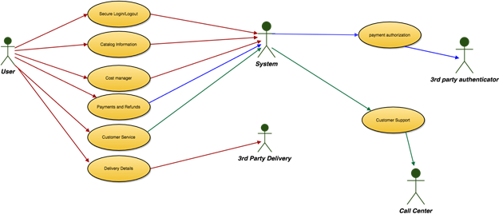
CUSTOMER PERSPECTIVE

Slide 10
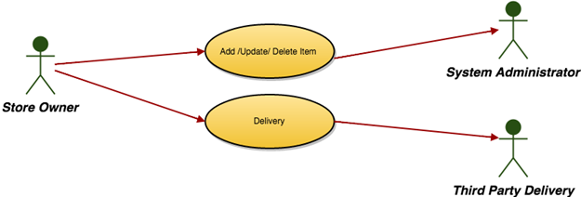
STORE OWNER’S PERSPECTIVE

Slide 11
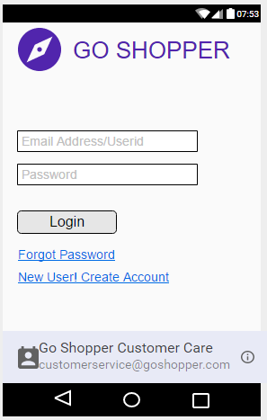
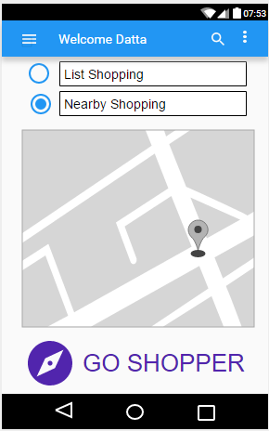
UI DESIGN
SIMPLE & GRACEFUL

Slide 12
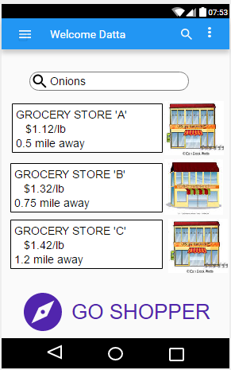
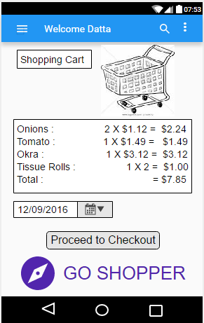
UI DESIGN 2
SIMPLE & GRACEFUL

Slide 13
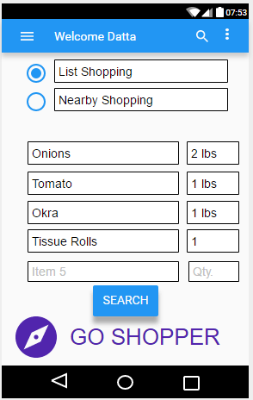
UI DESIGN 3
SIMPLE & GRACEFUL

Slide 14
PROFIT MODEL
ADVERTISEMENTS IN THE APP: Customers can pay a one-time price of $0.99 to remove the ads.
PREMIUM CUSTOMERS: Efficient cost manager (Selection from different Stores). Product Delivery at your doorstep
COUPONS (Advertising Strategy): Purchase coupons to discount selected items. (Coordinate with grocery stores to make these coupons valid)

Slide 15
ADVANTAGES OF GO SHOPPER
BEST DEALS from competing grocery stores.
‘SPECIFIC’ PRODUCTS ‘SPECIFIC’ STORES
By the principle of the free market, stores will follow customer trends and stock up on these items that customers want.
Get Fresh Products
Have access to updated inventory of all nearby grocery stores.

Slide 16
FUTURE WORK
WE WILL EXPAND GEOGRAPHICALLY We will launch our services in other metropolitan areas such as Chicago, New Orleans, and San Francisco
WELL CONNECTED SERVERS AND A SECURE NETWORK
HIRE GOOD TECHNICAL & MARKETING TEAMS

Slide 17
POST IMPLEMENTATION REVIEW
WHAT WE DID RIGHT? | WHAT WE DID WRONG? | WHAT WE WOULD CHANGE?
Explored Opportunities | We did not have scheduling for daily meets | Survey more potential customer
Realistic idea to implement | We surveyed only 30 students | We shall set up meetings daily and review work
Met goals and deadline on time. | We used the Waterfall method | We will implement the SCRUM method

Slide 18
Questions/ Answers

Slide 19
Thank You!

